Slide 1








Trading social status for genetics in marriage markets: Evidence from Great Britain and Norway
Abdel Abdellaoui Amsterdam UMC Oana Borcan University of East Anglia Pierre Chiappori Columbia David Hugh-Jones Idle Bum Fartein Ask Torvik Norwegian Institute of Public Health Eivind Ystrøm Norwegian Institute of Public Health
Prague, October 2023

Slide 2
Background
Genetics explains c. 50% of variation in many human characteristics.
What’s a social scientist to do?
One answer: make genetics the dependent variable.
Assortative mating
Hugh-Jones, Abdellaoui et al. (2016). Assortative Mating on Education Leads to Genetic Spousal Resemblance for Causal Alleles. Intelligence 59.
This paper…
Migration
Abdellaoui, Hugh-Jones, …, Visscher (2019). Genetic Correlates of Social Stratification in Great Britain. Nature Human Behaviour 3.
Natural selection
Hugh-Jones and Abdellaoui (2022). Human Capital Mediates Natural Selection in Contemporary Humans. Behavior Genetics 52:4.

Slide 3
Goals of this paper
In increasing order of ambition:
Explain a puzzle about the intergenerational persistence of inequality.
Provide a new explanation of the genes-SES (socio-economic status) gradient.
Rethink the nature of inequality in historical human societies.
Change how we think about genetic variation.

Slide 4
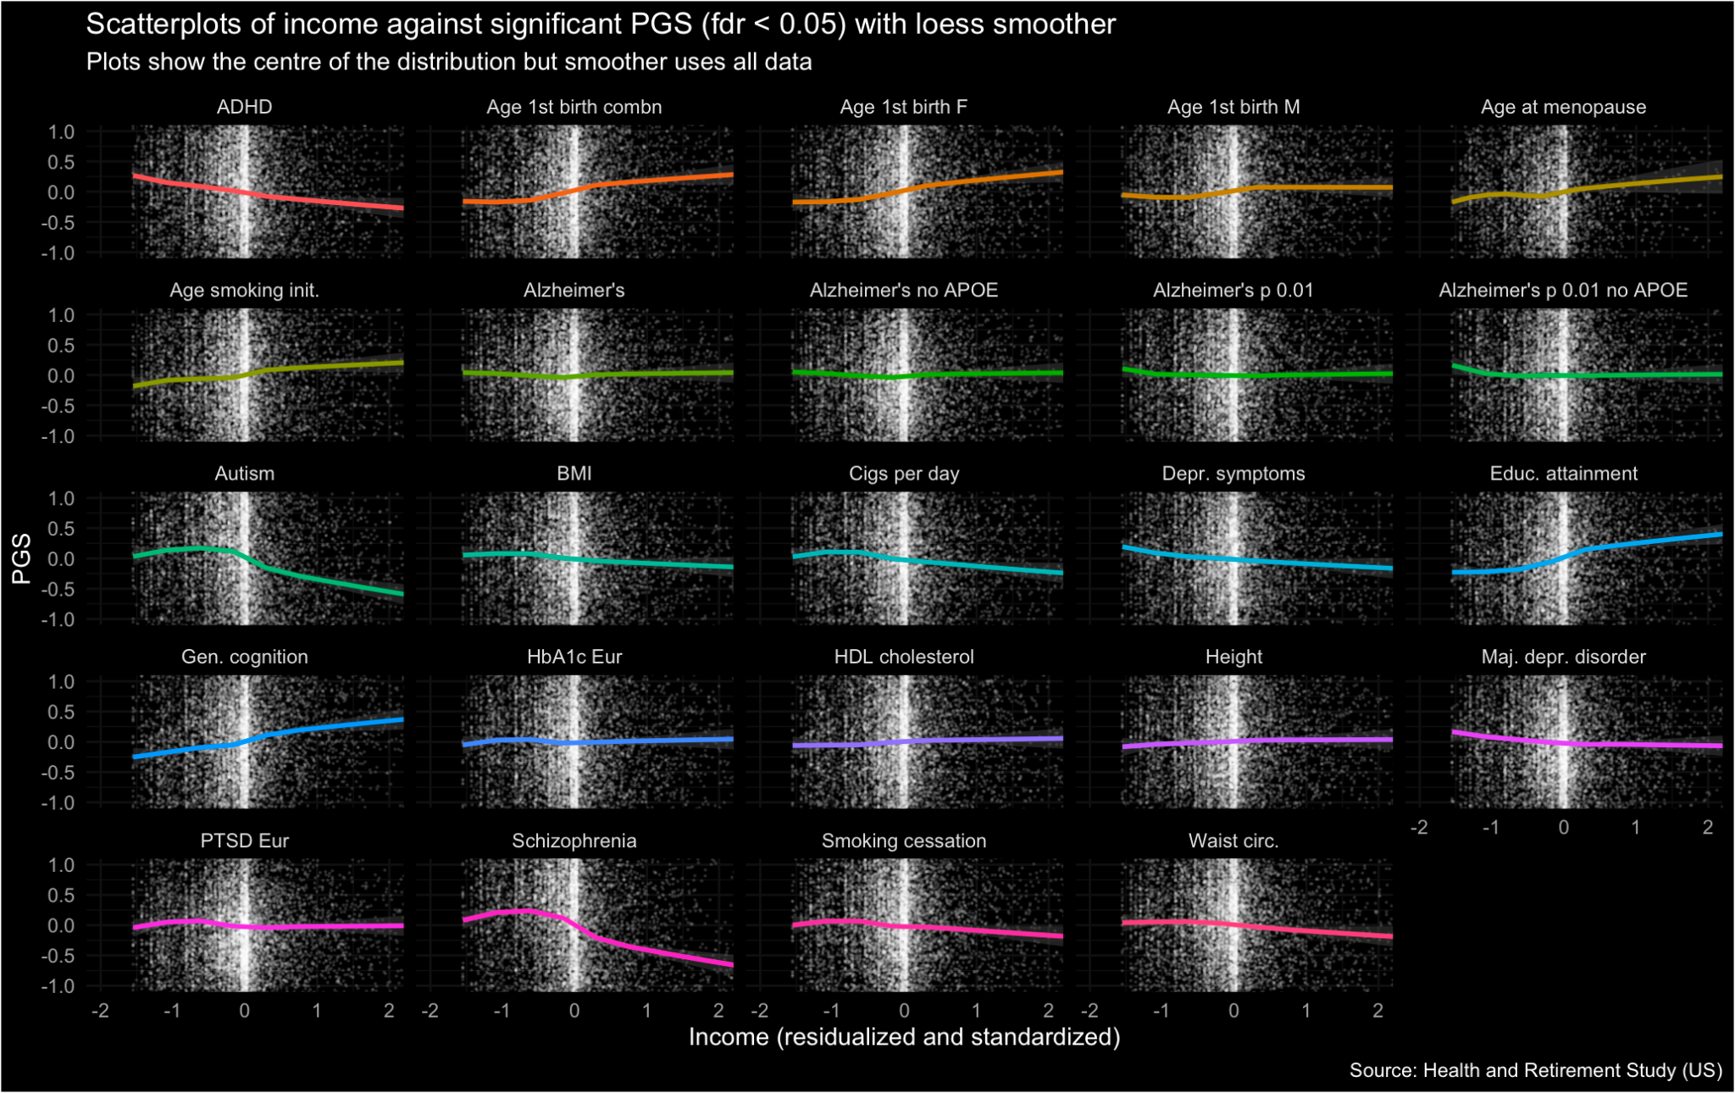
Genes-SES gradient

Slide 5
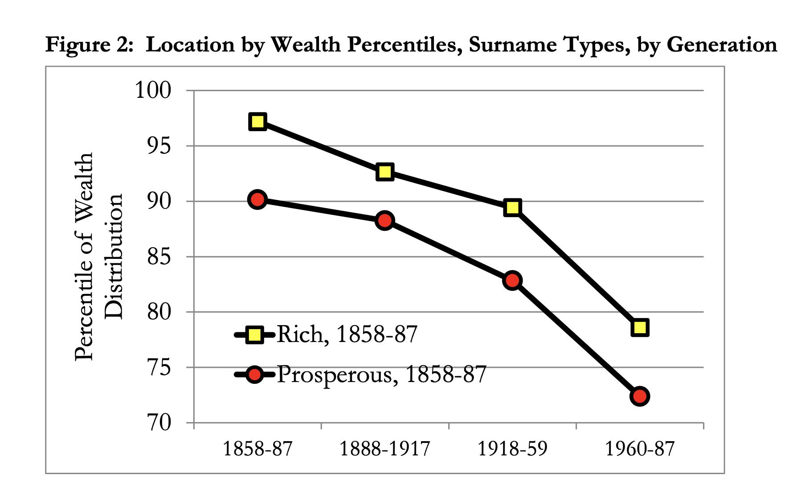
Long run inequality
“…wealth is much more persistent over generations than standard one generation estimates would suggest. There is still a significant correlation between the wealth of families five generations apart…. an
underlying Markov process of wealth inheritance with an intergenerational elasticity of 0.70-0.75”
Clark and Cummins (2015) “Intergenerational Mobility in England, 1858-2012. Wealth, Surnames, and Social Mobility.”

Slide 6
Many genetic measures, including polygenic scores for education and health outcomes, differ between people of low and high socio-economic status (SES).
The leading explanation for this genes-SES gradient is meritocracy: genetic variants that cause success in labour markets lead to upward mobility.
An alternative explanation: both some genetic variants, and high SES, are desirable qualities in marriage markets.
If you are rich or privileged, you may marry someone intelligent or good-looking.
Both SES and genetics are then inherited by the next generation.
Under Social-Genetic Assortative Mating:
Shocks to SES are reflected in the DNA of subsequent generations.
The size of the genes-SES gradient depends on social structure, e.g. on persistence of inherited wealth.
The genes-SES gradient is likely historically widespread, beyond modern meritocracies.

Slide 7
Literature
Large, mostly separate, literatures on assortative mating in economics and genetics.
Genetics: genetic assortative mating (GAM) (Rao, Morton, and Yee 1976; Heath and Eaves 1985; Otto, Christiansen, and Feldman 1995), including cross-trait assortative mating (Beauchamp et al. 2010; Sundet et al. 2005; Border et al. 2022).
Economics: models and empirics on assortative mating and inequality, including cross-trait assortative mating (Fernández and Rogerson 2001; Fernandez, Guner, and Knowles 2005; Eika, Mogstad, and Zafar 2019; Chiappori, Dias, and Meghir 2018).
Genetic theory predicted in the 1970s that genetically and culturally transmitted traits could become associated in the population (Rao, Morton, and Yee 1976).
Despite this, previous work has not drawn conclusions for the genes-SES gradient (e.g. Rimfeld et al. 2018) or made the link with social structure.
Ours is the first post-genomic revolution empirics to directly demonstrate SGAM.
Our model provides a microeconomic foundation for SGAM, which might help bridge the two literatures.

Slide 8
Model
Traits x₁ (genetic) and x₂ (SES) are normally distributed in the population.
Attractiveness is ax₁ + (1-a)x₂ where 0 ≤ a ≤ 1 is the relative importance of genes.
People mate assortatively.
Children inherit
x₁’ = τ (x₁ + y₁)/2 + ε
x₂’ = θ (x₂ + y₂)/2 + η
Where:
τ is close to 1 (genetic inheritance).
θ reflects persistence of SES (e.g. inheritance tax rate 1 - θ).

Slide 9
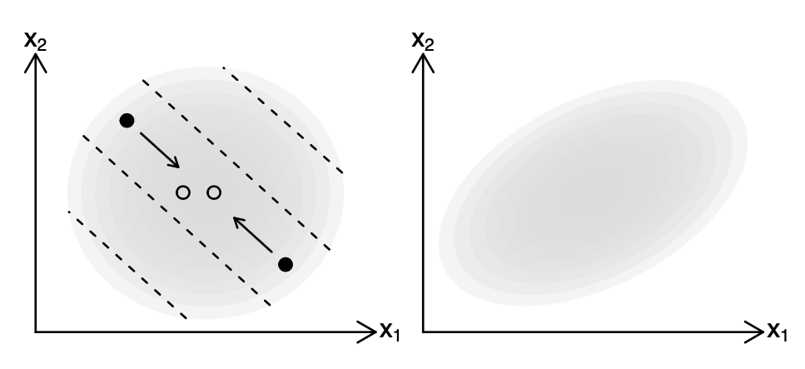
Intuition
Parents
Children
Parents (●) mate along iso-attractiveness curves.
Their children (○) are between them.
As a result, the children’s distribution is squashed along the attractiveness gradient.

Slide 10
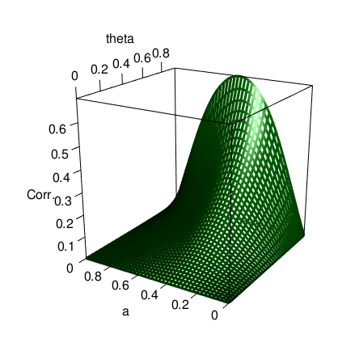
Result
If parents’ x₁ and x₂ are independent, children’s x₁’ and x₂’ are positively correlated for 0 < a < 1.
The correlation increases in persistence of SES (θ).
The same holds for the long-run distribution.
Extensions
Long-run correlation between x₁ and x₂ , by a and θ

Slide 11
Data
UK Biobank, a study of about 500,000 individuals born 1935-1970.
UKBB has no explicit information on spouse pairs. We match pairs manually, and check using genetic children of the pairs. This gives 35,682 spouse pairs.
MOBA, a study of about 90,000 mothers and babies born in Norway 1998-2008. About 70,000 fathers are included.

Slide 12
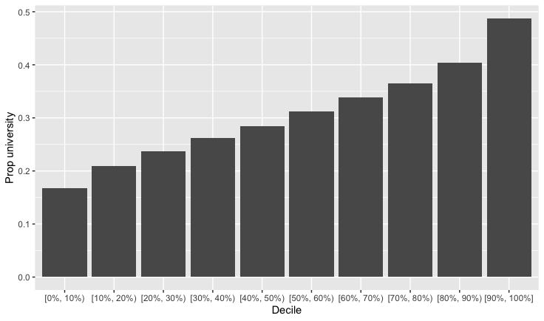
Polygenic Score for Educational Attainment
Our dependent variable is spouse’s Polygenic Score for Educational Attainment (PSEA).
Linear regression of probability of attending university on PSEA: 1 sd PSEA = 9.2 percentage points.
Within-siblings regression (causal): 4.5 percentage points.
👉 Substantial confounding with family environment, but large causal effects remain.
University attendance by PSEA decile

Slide 13
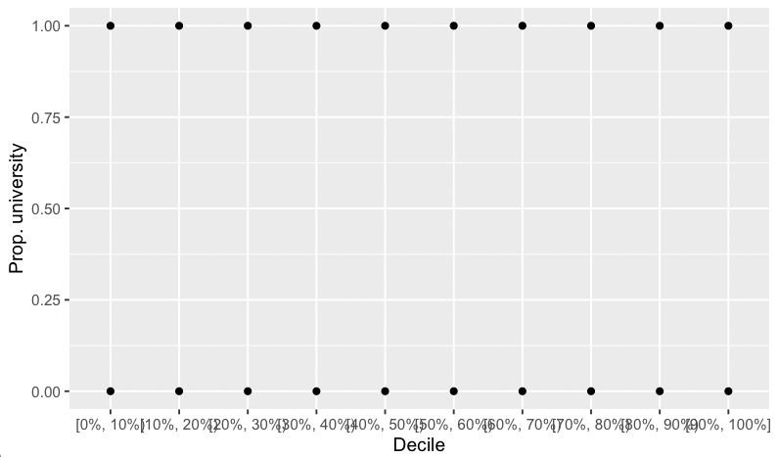
Polygenic Score for Educational Attainment
Our dependent variable is spouse’s Polygenic Score for Educational Attainment (PSEA).
Linear regression of probability of attending university on PSEA: 1 sd PSEA = 9.2 percentage points.
Within-siblings regression (causal): 4.5 percentage points.
👉 Substantial confounding with family environment, but large causal effects remain.
University attendance by PSEA decile

Slide 14

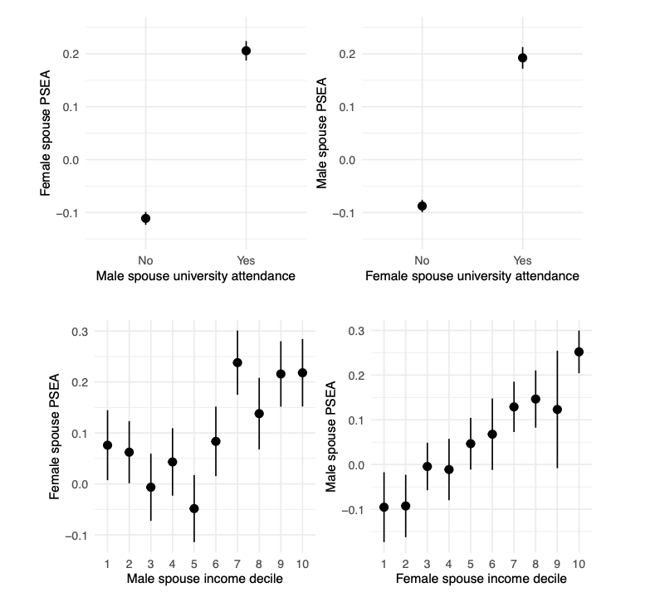

Slide 15
These results could be confounded by the focal individual’s own genetics.
We already know that there is assortative mating on PSEA (Hugh-Jones et al. 2016).
We need an independent variable which
affects SES;
is independent of genetics;
varies across a large enough N.
Polygenic scores and causes of variation in SES are noisy
The spouse matching process is unpredictable (Shakespeare 1595)
We use birth order.
Siblings have the same expected polygenic scores, by the “lottery of meiosis”.
Early-born siblings receive more parental care and have better life outcomes, including socio-economic status (SES).

Slide 16
Estimation strategy
Hard to justify instrumental variables:
Birth order affects other things than SES.
We only have imperfect measures of SES (estimated income, educational attainment).
Instead we run a mediation analysis:
Does birth order affect spouse’s PSEA?
Is the effect mediated by measures of SES?

Slide 17
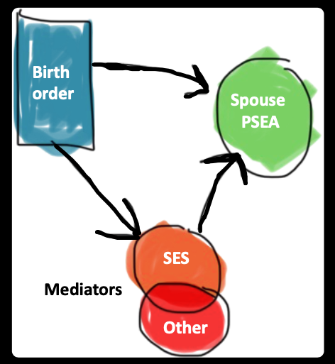
Estimation strategy
Hard to justify instrumental variables:
Birth order affects other things than SES.
We only have imperfect measures of SES (estimated income, educational attainment).
Instead we run a mediation analysis:
Does birth order affect spouse’s PSEA?
Is the effect mediated by measures of SES?
Mediators
Mediators

Slide 18
Controls and mediators
SES mediators
University attendance
Earnings (of first job, guesstimated from SOC code, in UK; decile at age 30 in Norway)
Non-SES mediators
Height
BMI
Fluid IQ & self-reported health (only in UKBB)
Controls
Family size
Month of birth, year of birth
Parent’s age at birth (only available for some respondents)

Slide 19
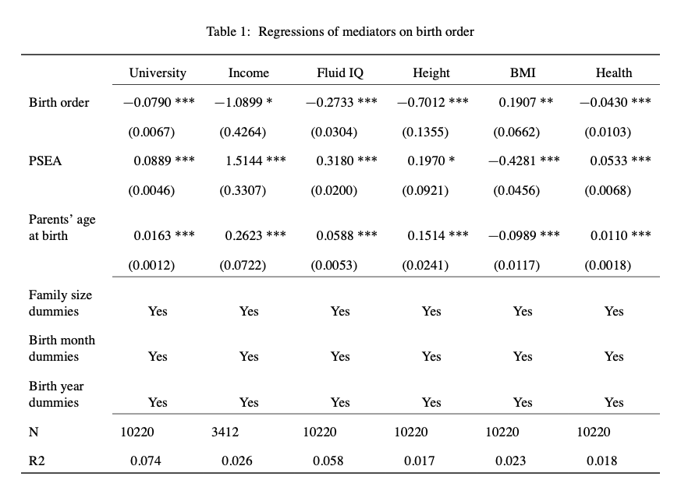
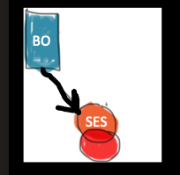

Slide 20
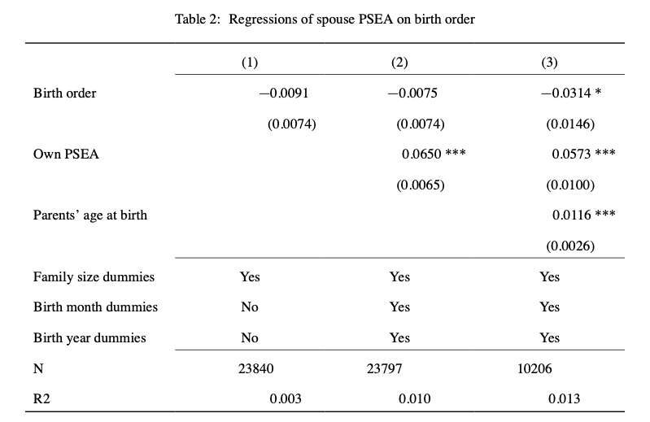
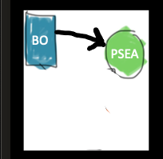

Slide 21
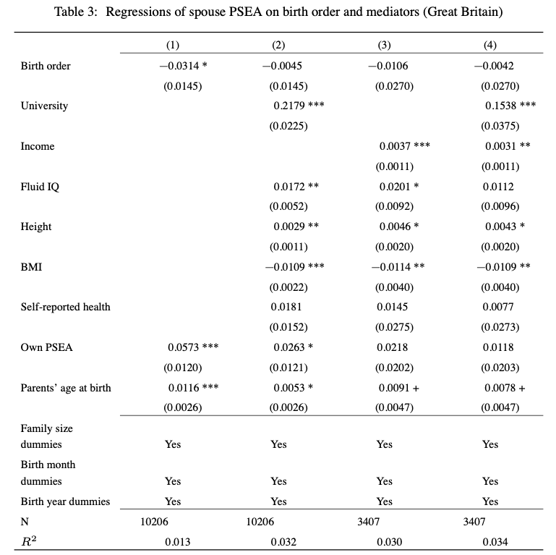
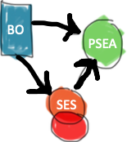
SES mediators
Non-SES mediators
Zoom

Slide 22
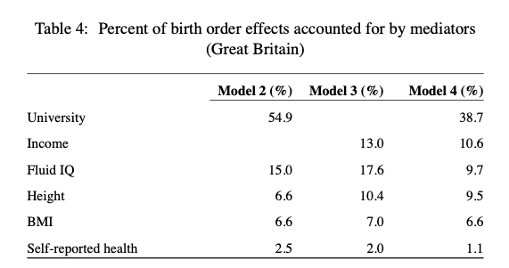
Robustness

Slide 23
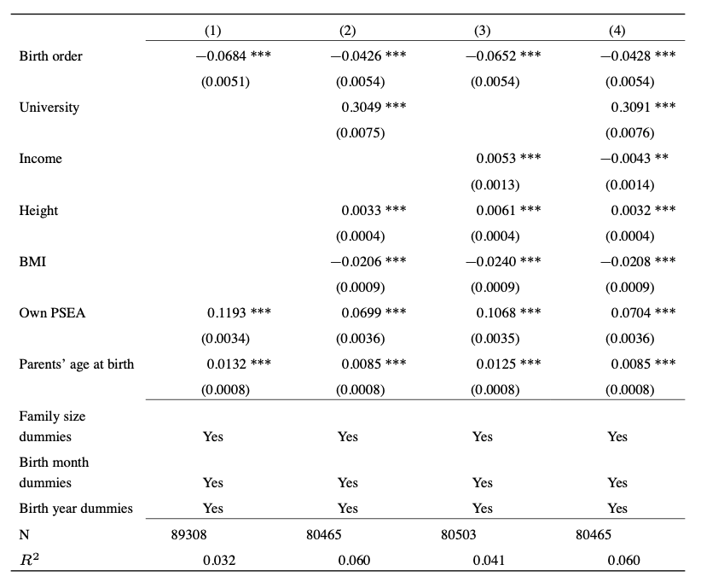

Mediators

Slide 24
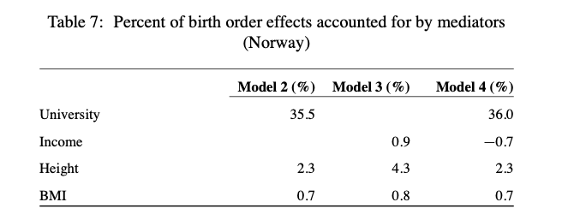
Mediators

Slide 25
Socio-Genetic Assortative Mating
Explain a puzzle about the intergenerational persistence of inequality.
Inequality can persist because of unmeasured genetic variation (Clark 2021). Genetics can be a mediator, not just a confound, for transmission of SES over generations.
Provide a new explanation of the genes-SES gradient.
In modern meritocracies, genes affect SES.
Under SGAM, in all societies, SES can affect genes.
Shocks to SES are reflected in the DNA of subsequent generations.
The size of the genes-SES gradient is affected by social institutions.
Some evidence that income matters more in Great Britain than Norway.
Rethink the nature of inequality in historical human societies.
Prediction: a genes-status gradient should be visible in ancient DNA.

Slide 26
Change how we think about genetic variation.
Yes, genes are “biological”…
But across generations, genetic variation is a social outcome.
Results from human genetics have been controversial, and will likely continue to be so.
Rather than banning research we think is harmful, perhaps it would help to take the perspective above:
“Genes are not special.”

Slide 27

Thank you!
Society
Genetics
“Part of the beauty of me is that I am very rich.”

Slide 28
Extensions
The basic result extends to non-normal/discontinuous distributions, and non-linear attractiveness.
We can allow “meritocracy”, where adult SES depends directly on own genes.
Genes-SES correlation may either increase or decrease in θ.
The a parameter can differ for men and women.
Genes-SES correlation is maximized when parameters are most different. (Intuition: then e.g. high-status males almost always match high-genetics females.)

Slide 29
Spouse pairs
Some respondents in the Biobank sample have a genetic child who is also in the sample.
Among our spouse pairs, 511 have a genetic child of at least one partner in the sample.
For 86% (441) of these, the child is the genetic child of both partners.
Comparison: 11% of families with dependent children included a stepchild in England and Wales in 2011 (National Statistics 2014).

Slide 30
Robustness
Extra mediators: BMI, self-reported health.
Birth order is independent of 33 different polygenic scores.
Results are qualitatively robust…
… if we use birth order dummies: strongest effect for first child versus subsequent children.
… using age left full-time education as the key mediator
… for males and females only (initial birth order coefficient is not significant)
… for couples with children

Slide 31
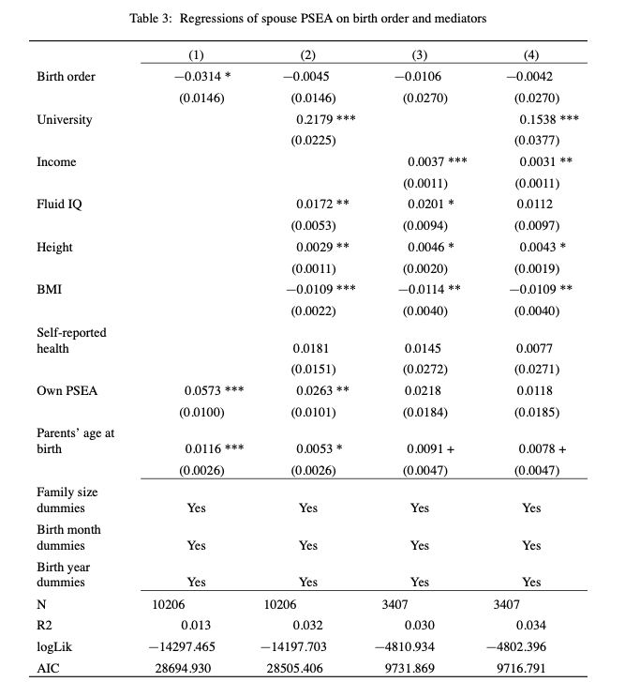
SES mediators
Non-SES mediators

Slide 32
Bibliography
Halsey, AH. 1958. “Genetics, Social Structure and Intelligence.” British Journal of Sociology 9 (1): 15–28.
Hugh-Jones, David, Karin JH Verweij, Beate St Pourcain, and Abdel Abdellaoui. 2016. “Assortative Mating on Educational Attainment Leads to Genetic Spousal Resemblance for Polygenic Scores.” Intelligence 59: 103–8.
Hugh-Jones, David and Abdel Abdellaoui. 2022. “Human capital mediates natural selection in contemporary humans “. Working paper.
Lindahl, Lena. 2008. “Do Birth Order and Family Size Matter for Intergenerational Income Mobility? Evidence from Sweden.” Applied Economics 40 (17): 2239–57.
National Statistics. 2014. “Stepfamilies in 2011.” https://webarchive.nationalarchives.gov.uk/20160105222243/http:// www.ons.gov.uk/ons/rel/family-demography/stepfamilies/2011/stepfamilies-rpt.html.
Rimfeld, Kaili, Eva Krapohl, Maciej Trzaskowski, Jonathan R. I. Coleman, Saskia Selzam, Philip S. Dale, Tonu Esko, Andres Metspalu, and Robert Plomin. 2018. “Genetic Influence on Social Outcomes During and After the Soviet Era in Estonia.” Nature Human Behaviour 2 (4): 269–75.
Schwartz, Christine R, and Robert D Mare. 2005. “Trends in Educational Assortative Marriage from 1940 to 2003.” Demography 42 (4): 621–46.
Shakespeare, William. 1595. A Midsummer Night’s Dream.
Solon, Gary. 2018. “What Do We Know so Far about Multigenerational Mobility?” The Economic Journal 128 (612): F340–52.
Tambs, Kristian, Jon Martin Sundet, Per Magnus, and K re Berg. 1989. “Genetic and Environmental Contributions to the Covariance Between Occupational Status, Educational Attainment, and IQ: A Study of Twins.” Behavior Genetics 19 (2): 209–22.
Trzaskowski, Maciej, Nicole Harlaar, Rosalind Arden, Eva Krapohl, Kaili Rimfeld, Andrew McMillan, Philip S. Dale, and Robert Plomin. 2014. “Genetic Influence on Family Socioeconomic Status and Childrens Intelligence.” Intelligence 42 (January): 83–88
Abdellaoui, Abdel, David Hugh-Jones, Löıc Yengo, Kathryn E Kemper, Michel G Nivard, Laura Veul, Yan Holtz, et al. 2019. “Genetic Correlates of Social Stratification in Great Britain.” Nature Human Behaviour 3 (12): 1332–42.
Black, Sandra E, Paul J Devereux, and Kjell G Salvanes. 2011. “Older and Wiser? Birth Order and IQ of Young Men.” CESifo Economic Studies 57 (1): 103–20.
Booth, Alison L, and Hiau Joo Kee. 2009. “Birth Order Matters: The Effect of Family Size and Birth Order on Educational Attainment.” Journal of Population Economics 22 (2): 367–97.
Clark, Gregory. 2021. “For Whom the Bell Curve Tolls: A Lineage of 400,000 English Individuals 1750-2020 Shows Genetics Determines Most Social Outcomes.” Working Paper. http://faculty.econ.ucdavis.edu/faculty/ gclark/ClarkGlasgow2021.pdf.
Clark, Gregory, and Neil Cummins. 2015. “Intergenerational Wealth Mobility in England, 1858–2012: Surnames and Social Mobility.” The Economic Journal 125 (582): 61–85.
Eika, Lasse, Magne Mogstad, and Basit Zafar. 2019. “Educational Assortative Mating and Household Income In- equality.” Journal of Political Economy 127 (6): 2795–835.
Fernandez, Raquel, Nezih Guner, and John Knowles. 2005. “Love and Money: A Theoretical and Empirical Analysis of Household Sorting and Inequality.” Quarterly Journal of Economics 120 (1): 273–344.
Fernández, Raquel, and Richard Rogerson. 2001. “Sorting and Long-Run Inequality.” Quarterly Journal of Economics 116 (4): 1305–41.
Furnham, Adrian. 1993. “Just World Beliefs in Twelve Societies.” Journal of Social Psychology 133 (3): 317–29.
Gramsci, Antonio. 1971. Selections from the Prison Notebooks. Lawrence; Wishart London.
Greenwood, Jeremy, Nezih Guner, Georgi Kocharkov, and Cezar Santos. 2014. “Marry Your Like: Assortative Mating and Income Inequality.” American Economic Review 104 (5): 348–53.

